Slide 1
FYI: This is livestreaming on CNCF’s Twitch channel
Please feel free to turn off video/sound if you are more comfortable that way
Notes:
[Priyanka]

Slide 2
Inclusive Naming Initiative Kick-off
November 19, 2020
Notes:
[Priyanka]

Slide 3








Intro: Inclusive Naming Initiative
Cross-organizational Collaboration
inclusivenaming.org
Focused on providing meaningful assistance to the critical mass of enthused open source projects and other codebases to make language changes in a thoughtful way that is in sync with the rest of the ecosystem so that we all only have to Do It Once! ™ :p
Notes:
[Priyanka]

Slide 4
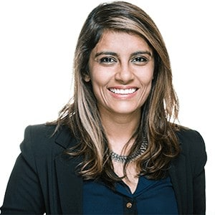
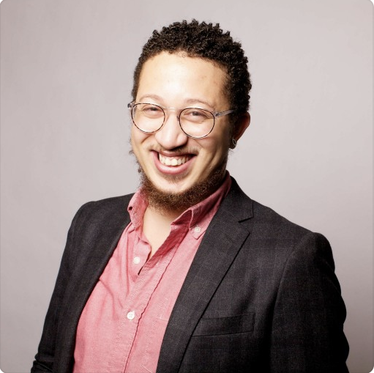
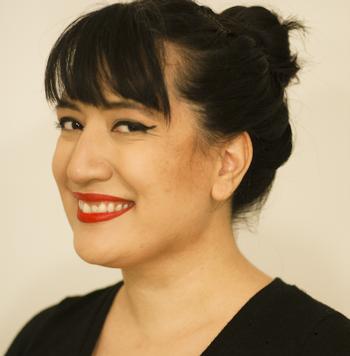
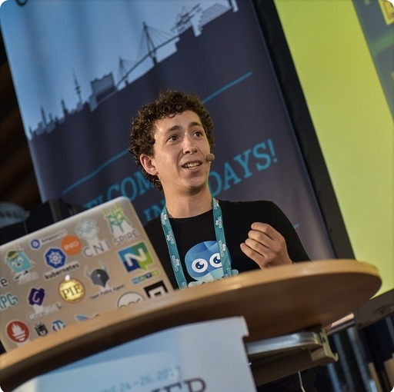
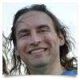
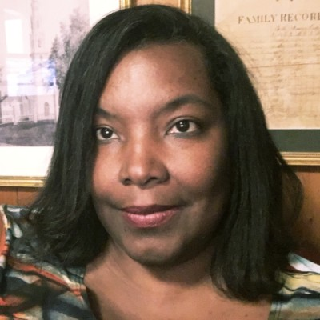
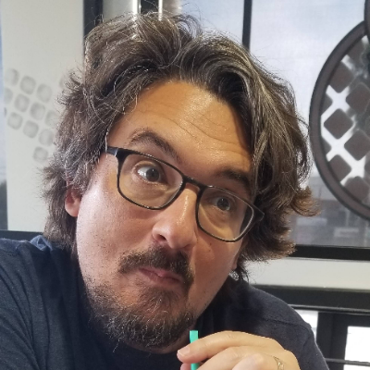
Priyanka Sharma
General Manager
CNCF
Stephen Augustus
Sr. Open Source Engineer VMWare
Celeste Horgan
Sr. Technical Writer
CNCF
Bill Mulligan
Marketing Manager
CNCF
You!
Ed Warnicke
Distinguished Engineer
Cisco
Dale Davis Jones
VP & Distinguished Engineer
IBM
Jason Brooks
Manager, OSPO
Red Hat
You
We’re seeking participants!
Notes:
[Priyanka] This is the bootstrap team!

Slide 5
CNCF Mission
The Foundation’s mission is to make cloud native computing ubiquitous.
The CNCF Cloud Native Definition v1.0 says:
The Cloud Native Computing Foundation seeks to drive adoption of this paradigm by fostering and sustaining an ecosystem of open source, vendor-neutral projects. We democratize state-of-the-art patterns to make these innovations accessible for everyone.
Notes:
[Priyanka (Bill?)]

Slide 6
CNCF Involvement

Slide 7
The Connection with Language
The CNCF has been successful so far because of our diversity-powered resilience
Naming can create barriers to contribution and adoption limiting the growth and adoption of technology.
Replacing harmful language with neutral terms including but is not limited to language linked to racism, sexism, homophobia, transphobia, ableism, or discrimination against any underrepresented group will help remove these barriers.
And making strides to improve the clarity of codebases and documentation by replacing idioms, metaphors, and slang specific to the English language.
Notes:
[Priyanka(bill?)]

Slide 8
Our Goal
Enable the industry to
remove harmful and unclear language and replace it with an agreed-upon set of neutral terms by providing tangible tools and recognition
Notes:
[Priyanka (bill?)]

Slide 9
People > Process > Tools
Notes:
[Celeste?]

Slide 10
People
OSS Communities/Projects
Standards Bodies
Companies/Private Codebases
YOU!
Everyone can contribute in the foundation of doers
Notes:
[Celeste]

Slide 11
FOR REVIEW: Processes and Tools
We drew inspiration from the excellent work in the k8s project and started creating blueprints.
Word Replacement List
Our current recommendations for replacement
Implementation Path
A suggested implementation path for changes for open source projects
More at https://inclusivenaming.org/!
Notes:
[Celeste]
One of the work streams we’re interested in pursuing and hope to get volunteers to work on is what the implementation path looks like for

Slide 12

What we want to avoid
Notes:
[Celeste]

Slide 13
Combine Rather than Create New Efforts
The Inclusive Naming Initiative already brings the initial efforts from founding members and community groups, including:
IBM and Red Hat
Kubernetes Naming Working Group
LF Networking Inclusive Language Initiative
You??
Notes:
[Celeste]

Slide 14
The Future!
Notes:
[Stephen?]

Slide 15
Roadmap
Q1 2021
Define best practices and replacements with the community, providing documents and tools for folx to get started
Discuss at KCCEU community meeting
Q3 2021
Showcase case studies and success stories
Share wins at KCCNA 2021
Q4 2021(based on market demand)
Develop certification program
Notes:
[Stephen?]

Slide 16
How to get involved as an individual
Join the mailing list:
inclusivenaming@googlegroups.com
Bi-weekly meeting: Mondays @ 9:15 Pacific Time
Join the mailing list, get an invite!
Notes:
[Stephen?]

Slide 17
How to get involved as an organization
Join the mailing list to receive project updates and invitations to community meetings
Identify key people in your organization who can represent this effort in an ongoing fashion
Read our Implementation Guide and other resources to start making effective changes
Notes:
[Stephen?]

Slide 18
Brainstorming session
What work do you want to see this group accomplish? What do you want to get done?
Google Doc
Notes:
[Celeste - notetaker? Stephen - Moderator?]

Slide 19
Contact Person
Mailing list should be your first stop!
Bill Mulligan - bmulligan@linuxfoundation.org
Notes:
[Priyanka for wrapup]

Slide 20
Appendix
Previous talks
OSS EU - Panel at OSS EU with IBM, GitHub, Kubernetes/VMWare, SDDI, CNCF https://www.youtube.com/watch?v=cLkxrX3i-HY
Data Conference - Fireside chat with Dale Davis of IBM https://developer.ibm.com/conferences/digital-developer-conference-data-ai/track-4-data-competitions-open-source/session-9-competition-exclusionary-language/
Notes:
[Priyanka]

